Slide 1

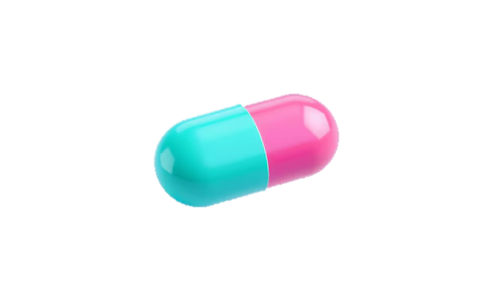

JSS ACADEMY OF HIGHER EDUCATION & RESEARCH
Department of Biotechnology and Bioinformatics
I SEMESTER MOLECULAR BIOLOGY (DSC 02)
Seminar Presentation
Role of Computer Aided Drug Design in Modern Drug Discovery

Slide 2

What is a Drug?
Role of Computer Aided Drug Design in Modern Drug Discovery
COURSE COORDINATOR
Dr. Mohan T C
PRESENTED BY
Jwalamala Jain S
Aishwarya M
Chaithra S Sannagoudar
S Varsha
A chemical substance, typically of known structure, which when administered to living organisms produces a biological effect.

Slide 3
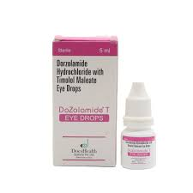
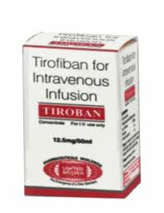
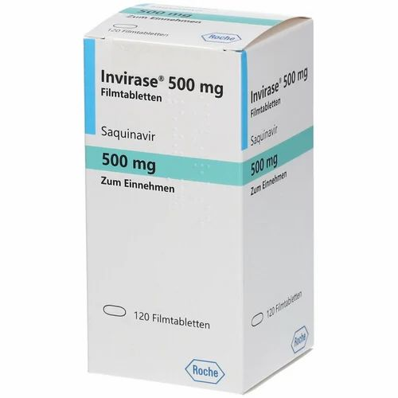
What is a Drug?
A chemical substance, typically of known structure, which when administered to living organisms produces a biological effect.
CADD
Computer Aided Drug Design
Use of computational techniques and tools to facilitate the development of new drugs using molecular modeling, simulations and algorithms.
Drugs discovered using CADD
Tirofiban
Saquinavir
Dorzolamide

Slide 4
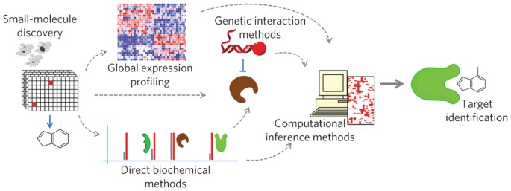
CADD
Computer Aided Drug Design
Use of computational techniques and tools to facilitate the development of new drugs using molecular modeling, simulations and algorithms.
Drugs discovered using CADD
Tirofiban
Saquinavir
Dorzolamide
Chemical biology in target identification and validation
Enzyme assay and biochemical tests: When target structure information is available
DNA and RNA analysis methods: Using genetic or genomic methods
Computational inference methods

Slide 5
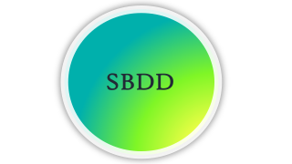
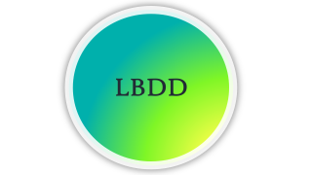
Chemical biology in target identification and validation
Enzyme assay and biochemical tests: When target structure information is available
DNA and RNA analysis methods: Using genetic or genomic methods
Computational inference methods
CADD Drug Discovery Process
CADD
Binding Site Identification
Pharmacophore Modelling
QSAR
Docking
Scoring
Virtual Screening
New Drug
Compound Selection
Lead Optimization

Slide 6
CADD Drug Discovery Process
CADD
Binding Site Identification
Pharmacophore Modelling
QSAR
Docking
Scoring
Virtual Screening
New Drug
Compound Selection
Lead Optimization

Slide 7
CADD
Binding Site Identification
Pharmacophore Modelling
QSAR
CADD Drug Discovery Process
Docking
Scoring
Virtual Screening
New Drug
Compound Selection
Lead Optimization

Slide 8
CADD Drug Discovery Process
CADD
Binding Site Identification
Pharmacophore Modelling
QSAR
Docking
Scoring
Virtual Screening
New Drug
Compound Selection
Lead Optimization

Slide 9
SBDD

Slide 10
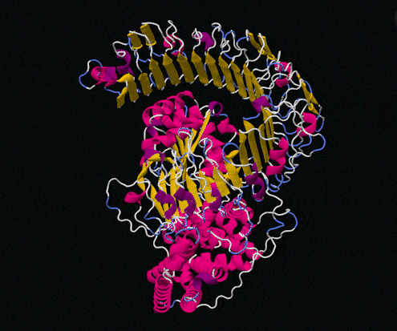
SBDD: Structure Based Drug Design
It relies on the 3-dimensional structure of biological target to design new drugs.
The key idea behind SBDD is to understand the interaction between drug and target at atomic level.

Slide 11





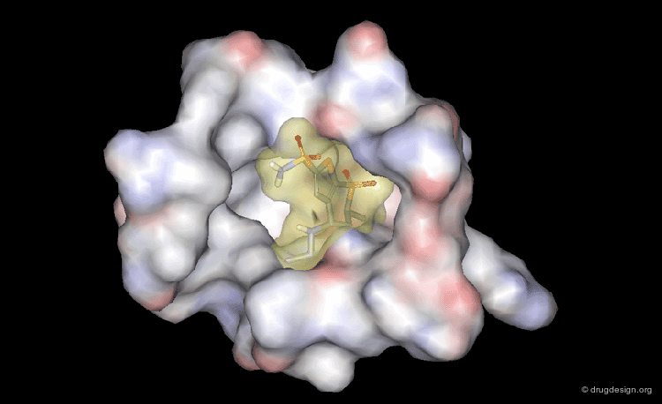
1. Experimental data
Data that is produced by a scientific experiment, test, measurement or experimental design.
2. De novo design
Exploits information from 3D receptor to find small fragments that match well with binding site.
1.
2.
4.
3. Virtual screening
A computational technique applied to identify novel drug from chemical compound libraries.
4. Validation
Process of establishing their reliability and validity, ensuring their accuracy.
3.
Binding Site Identification
Binding site is the pocket or cavity on the surface of the protein where ligand or drug molecule binds.
Program | Description
SiteComp Lin et al. | Binding site comparison based on molecular interaction fields
Cavitator Gao and Skolnick | Pocket prediction using a grid based geometric analysis

Slide 12
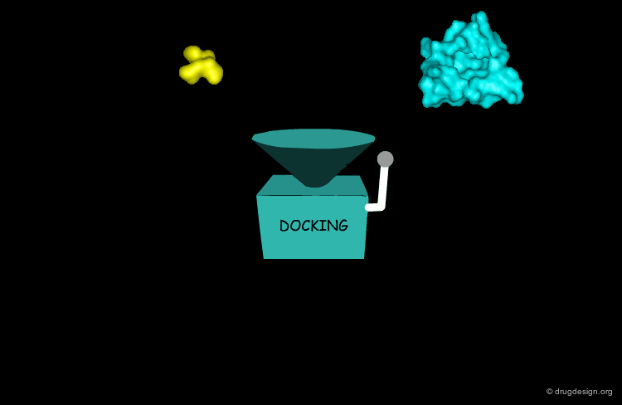
Binding Site Identification
Binding site is the pocket or cavity on the surface of the protein where ligand or drug molecule binds.
Program | Description
SiteComp Lin et al. | Binding site comparison based on molecular interaction fields
Cavitator Gao and Skolnick | Pocket prediction using a grid based geometric analysis
Docking
Molecular docking is one of the most well-known SBDD methods.
This method predicts the possible binding modes of a compound in a particular target binding site.
Program | Description
Docking server | Flexible side chains
cDocker | Rigid body rotation followed by simulated annealing

Slide 13
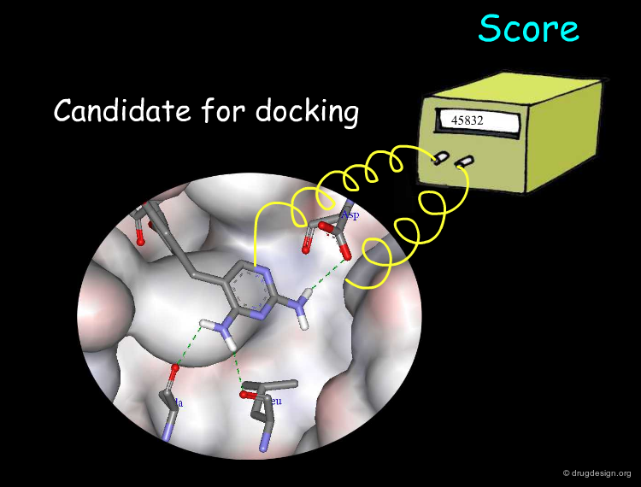
Docking
Molecular docking is one of the most well-known SBDD methods.
This method predicts the possible binding modes of a compound in a particular target binding site.
Program | Description
Docking server | Flexible side chains
cDocker | Rigid body rotation followed by simulated annealing
Scoring
It is a computational method that evaluates interaction between the compound and targets.
To identify active compounds frequently used scoring functions are:-
Force field based
Empirical based function
Knowledge based function

Slide 14
Scoring
It is a computational method that evaluates interaction between the compound and targets.
To identify active compounds frequently used scoring functions are:-
Force field based
Empirical based function
Knowledge based function

Slide 15
LBDD

Slide 16
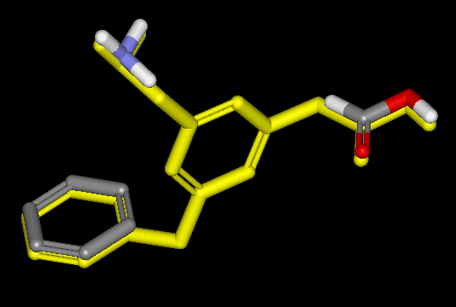
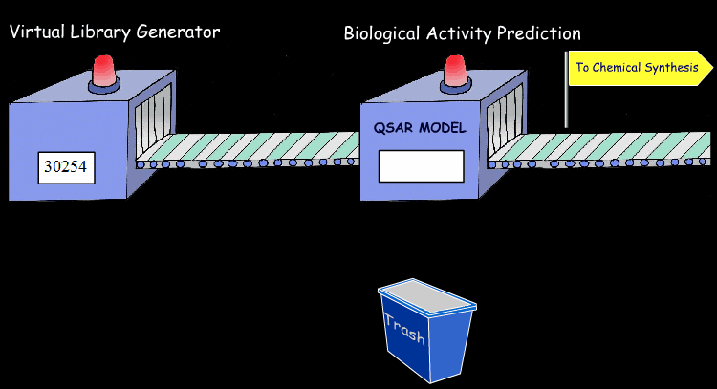
LBDD: Ligand Based Drug Design
LBDD is a drug discovery method that uses the biological activity of a ligand to create new drugs that interact with a specific target.
QSAR
Quantitative structure-activity relationship
QSAR=chemical structure of a drug *Biological activity

Slide 17
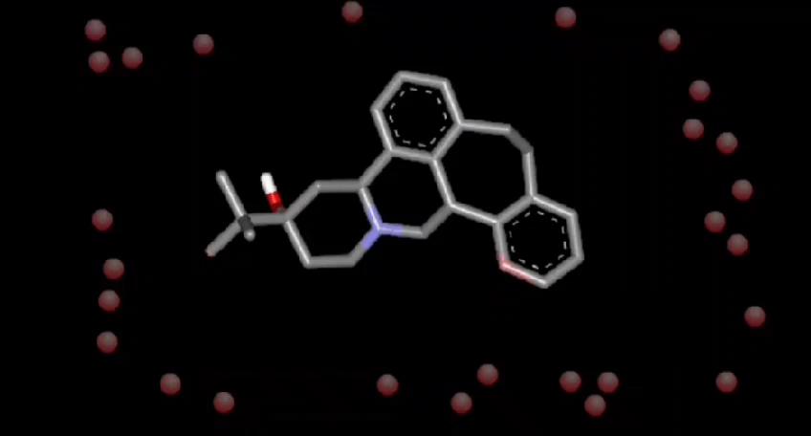
QSAR
Quantitative structure-activity relationship
QSAR=chemical structure of a drug *Biological activity
Pharmacophore Modelling
Defines the relative positions of the binding groups.
Helps to know Active conformation.
Defines the essential features of one or more molecules with the same biological activity.

Slide 18
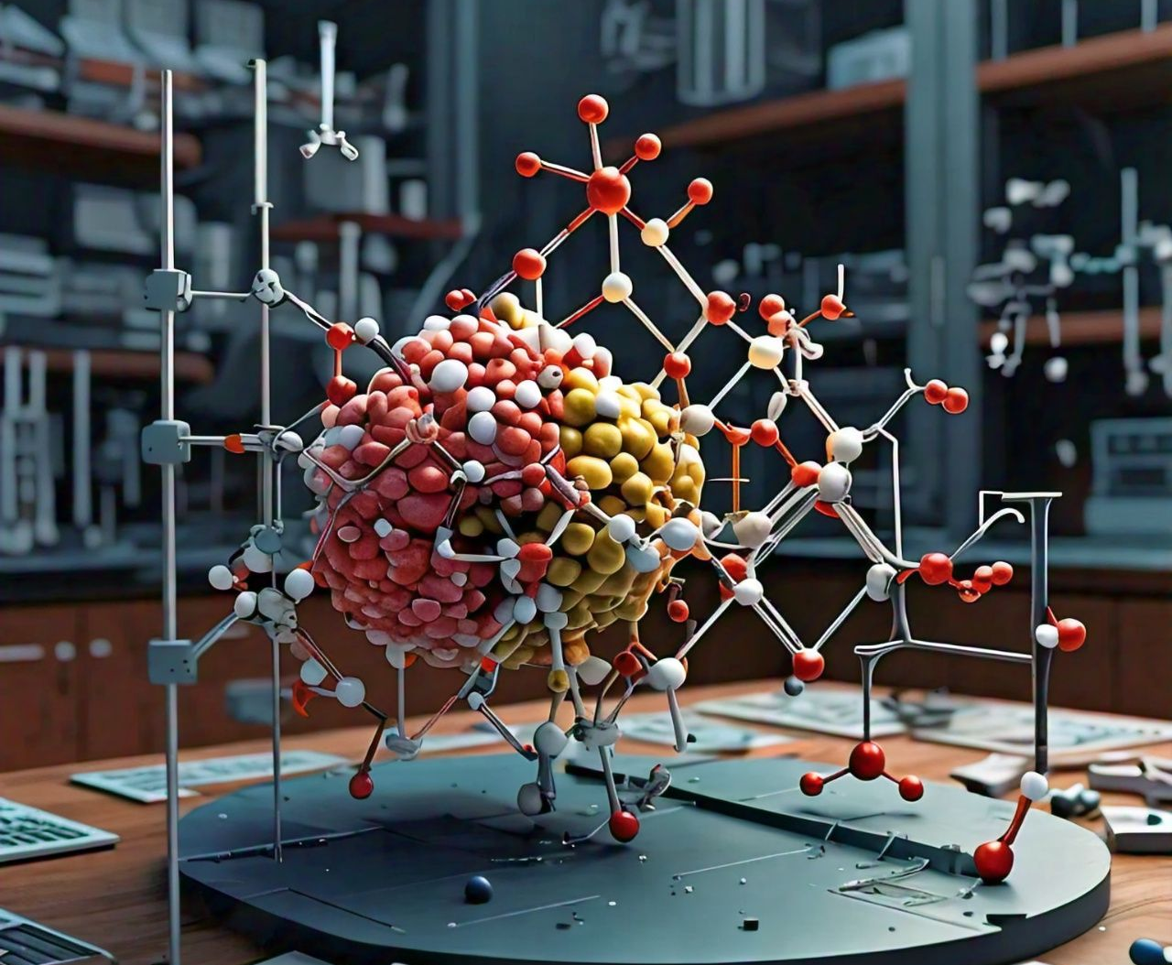
Pharmacophore Modelling
Defines the relative positions of the binding groups.
Helps to know Active conformation.
Defines the essential features of one or more molecules with the same biological activity.
3D QSAR
Based on mapping and comparison of steric and electrostatic field around set of ligands.

Slide 19
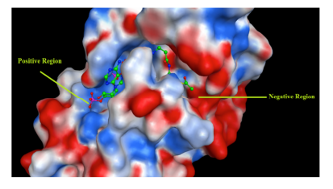
3D QSAR
Based on mapping and comparison of steric and electrostatic field around set of ligands.
SBDD Discovered Drug
TH1834: A Tip60 (histone acetyltransferase) inhibitor
Homology modeling of Tip60
SBDD: Tip60 inhibitor to fit a specific pocket
TH1834:
Inhibits Tip60 activity in vitro.
Results in apoptosis.
Structure of Tip60 HAT

Slide 20
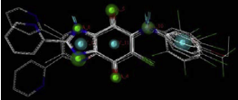
SBDD Discovered Drug
TH1834: A Tip60 (histone acetyltransferase) inhibitor
Homology modeling of Tip60
SBDD: Tip60 inhibitor to fit a specific pocket
TH1834:
Inhibits Tip60 activity in vitro.
Results in apoptosis.
Structure of Tip60 HAT
LBDD Discovered Drug
3D-QSAR studies of heterocyclic quinones with inhibitory activity on vascular smooth muscle cell proliferation using pharmacophore modelling
Coronary artery atherosclerosis
Heterocyclic quinone derivatives have inhibitory activity on rat aortic smooth muscle cell (RAoSMC) proliferation.
Refined pharmacophore models.
Pharmacophore Model

Slide 21
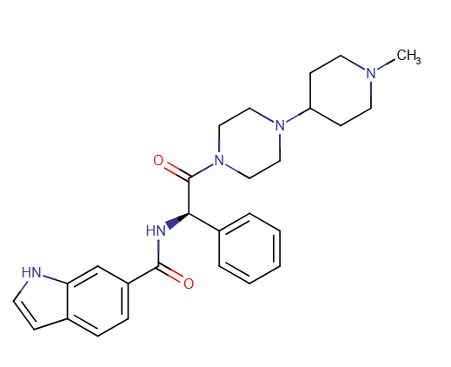
LBDD Discovered Drug
3D-QSAR studies of heterocyclic quinones with inhibitory activity on vascular smooth muscle cell proliferation using pharmacophore modelling
Coronary artery atherosclerosis
Heterocyclic quinone derivatives have inhibitory activity on rat aortic smooth muscle cell (RAoSMC) proliferation.
Refined pharmacophore models.
Pharmacophore Model
Integration of drug discovery tools
LY-517717: venous thromboembolism in hip or knee surgery patients
Oral inhibitor of activated factor Xa
Discovered combining:
in silico de novo drug design
structure-based lead optimization
Structure of LY-517717

Slide 22
Integration of drug discovery tools
LY-517717: venous thromboembolism in hip or knee surgery patients
Oral inhibitor of activated factor Xa
Discovered combining:
in silico de novo drug design
structure-based lead optimization
Structure of LY-517717
Conclusion
Challenges:
Targeting receptors with little to no structural information
Increasing computational efficiency
Complex biological targets​
Opportunities:
AI
Personalized Medicine

Slide 23
Conclusion
Challenges:
Targeting receptors with little to no structural information
Increasing computational efficiency
Complex biological targets​
Opportunities:
AI
Personalized Medicine
Thank You

Slide 24
Thank You

